Slide 1


TEAM
3+2

Slide 2

CONTENT
01
ABOUT US
02
TEAM GOALS & OBJECTIVES
03
TEAM VALUES & BEHAVIOURS
04
ROLES & RESPONSIBILITIES
05
OUR TEAM

Slide 3



ABOUT US
We decided to undertake this Practera industry project as we wanted to challenge ourselves and try something different while meeting new people and expanding our network.
One thing we all have in common is we were all born overseas, so we’re a very diverse team!

Slide 4





GOALS AND OBJECTIVES
Objective n° 1
Objective No. 2
Objective No. 1
Evaluate Market Trends and Changing Customer Needs in Disability Services
Explore Opportunities for Partnership and Community Engagement

Slide 5



VALUES & BEHAVIOURS
Values
Respect
Value the opinions, perspectives, and contributions of others.
Foster an environment of inclusivity and fairness.
Collaboration
Work together to achieve common goals, sharing knowledge and resources.
Encourage open communication and constructive feedback.
Behaviours
Proactive Problem-Solving
Identify issues early and propose practical, value-driven solutions.
Seek help or escalate when necessary, while contributing to finding resolutions.
Collaboration
Work together effectively, sharing ideas, resources, and responsibilities to achieve common goals.
Offer help when needed and proactively seek input from others.

Slide 6

ROLES & RESPONSIBILITIES
Project Manager
Creating and keeping a clear project plan, organising team meetings and providing an agenda 1 day before, providing updates to the client on the team’s progress.
Business Analyst
Bridges the gap between stakeholders and the technical team by gathering and analyzing requirements.
Data Analyst
Analyzes data to guide decision-making, improve features, and track performance metrics.

Slide 7



ROLES & RESPONSIBILITIES
Marketing Specialist:
Handles product launches, branding, and communication with the target audience.
Progress Monitor
Monitoring involves tracking progress, ensuring quality, addressing issues, and maintaining alignment with project goals.
Co-ordinator
Tasks include: Assist in data collection, organization, and entry. Facilitate communication among team members. Address any logistical, administrative, or team-related challenges

Slide 8



ROLES & RESPONSIBILITIES
Research Analyst
Strategically challenges assumptions by evaluating accessibility of organisations against benchmarks and delivers data-driven insights through visualizations.

Slide 9
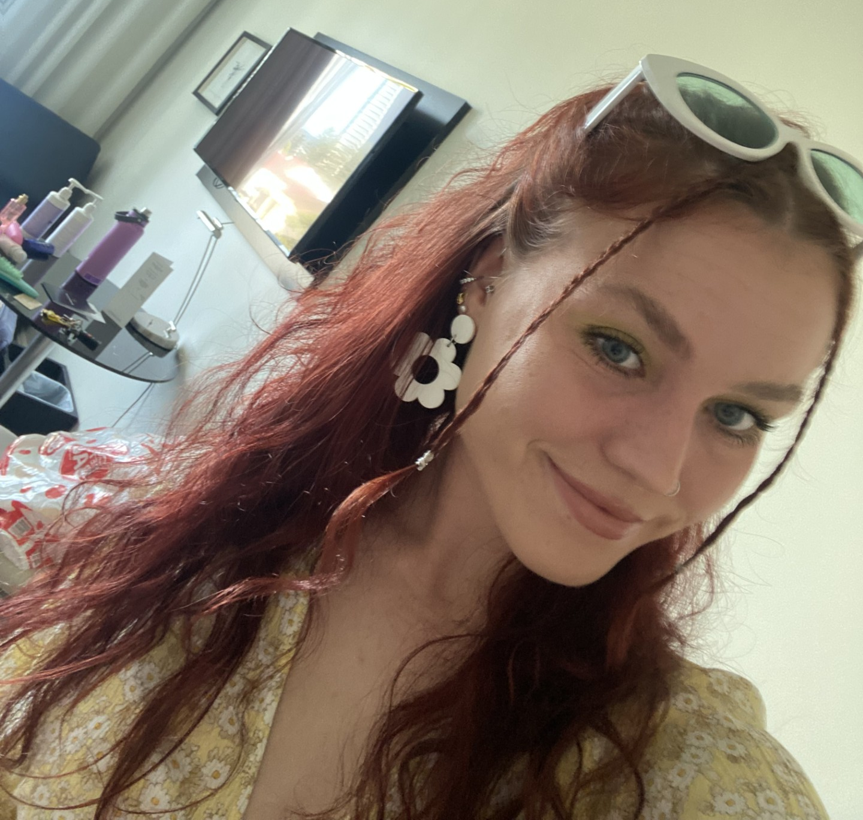

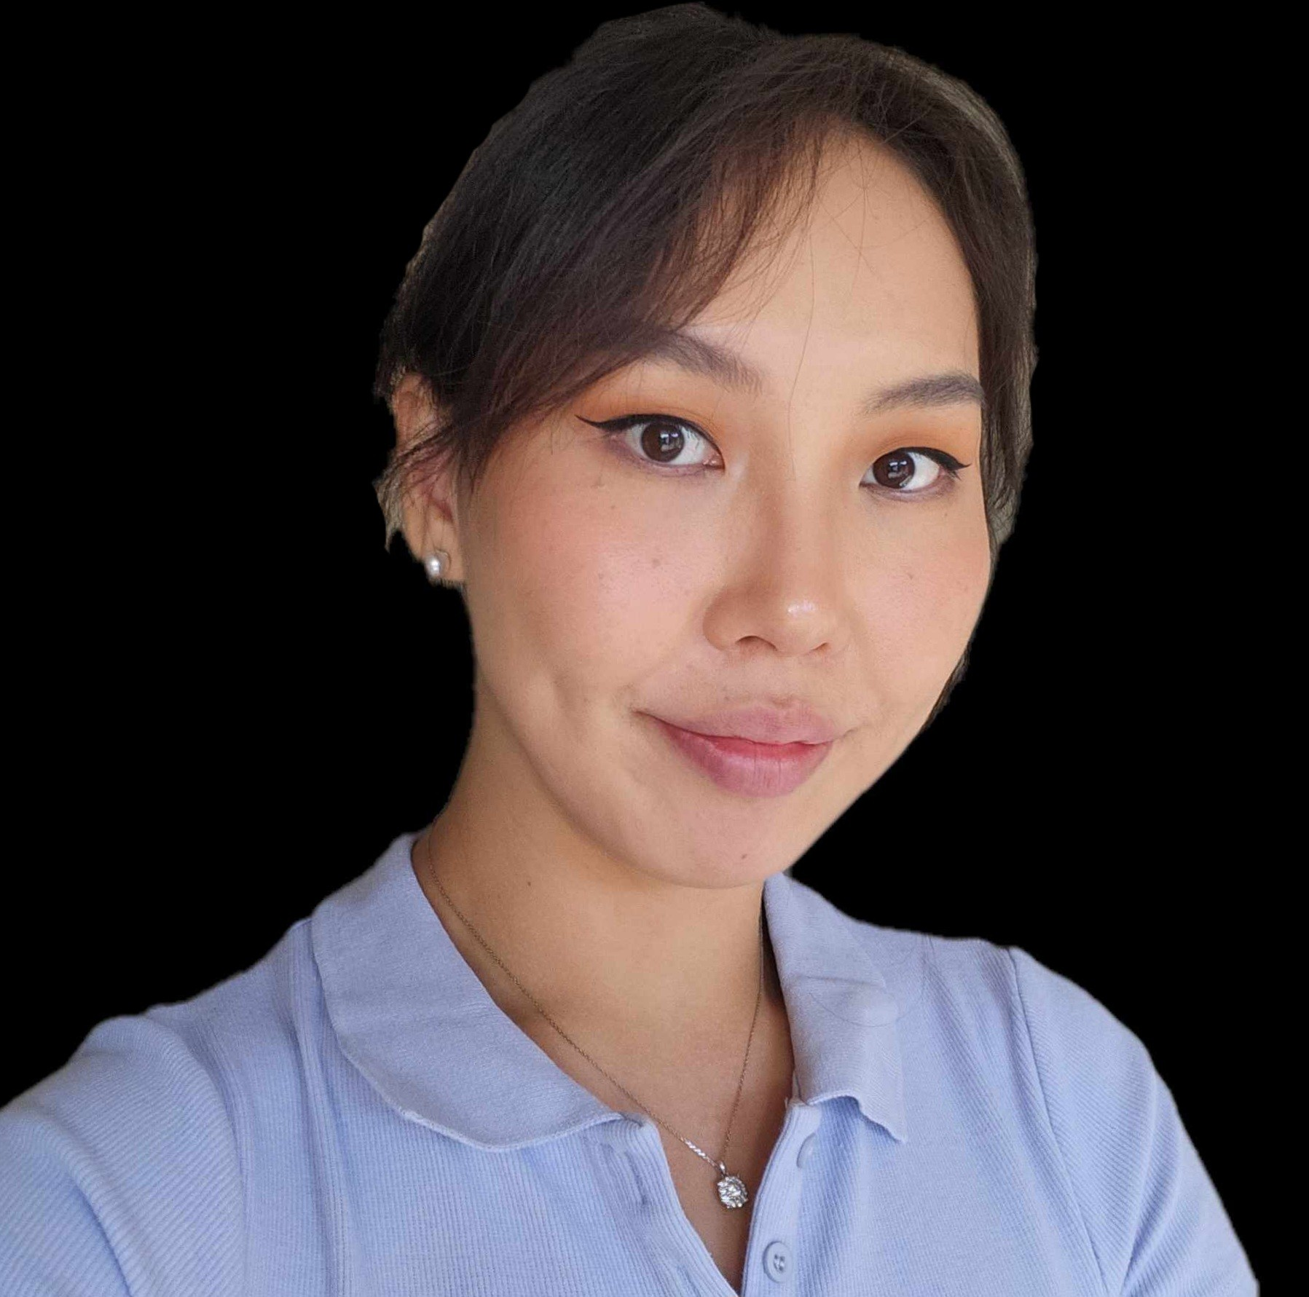
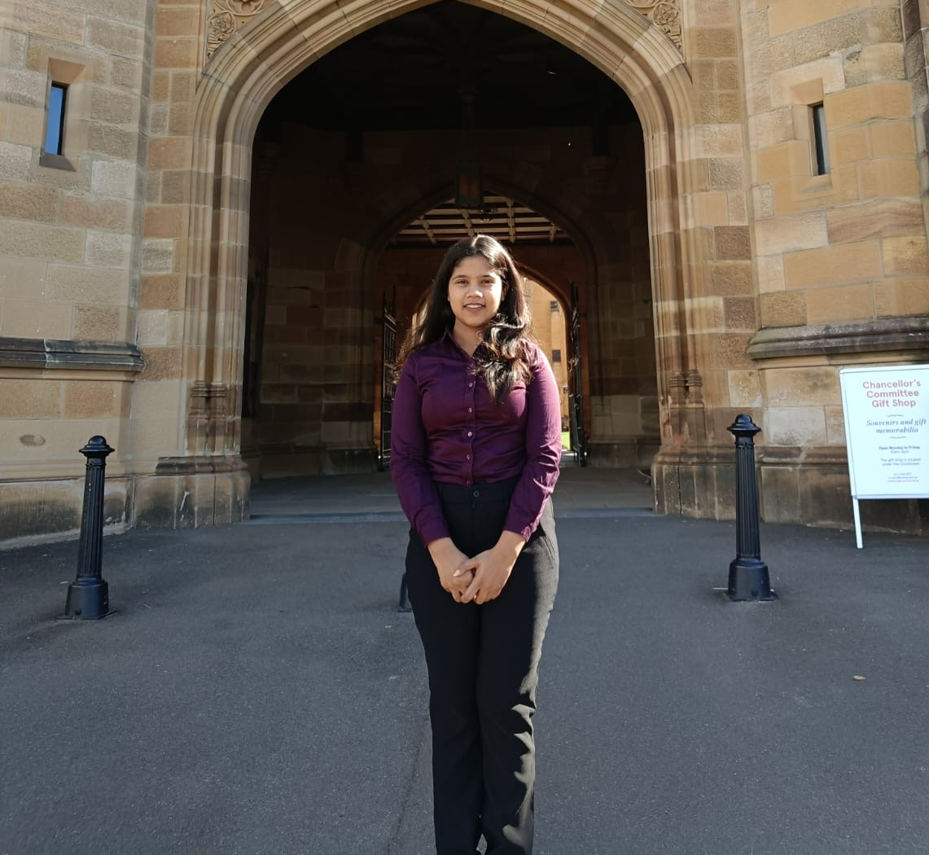

OUR TEAM
Insert photo
Insert photo
Insert photo
Grace
Project Manager
Keerthi
Research Analyst
Nomuunaa
Business Analyst
Insert photo
Insert photo
Insert photo
Insert photo
Tripti
Co-ordinator
Name
Role
Jason
Progress Monitor
Qi
Marketing Specialist
Lisi
Data Analyst

